Slide 1
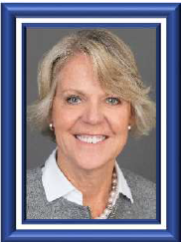
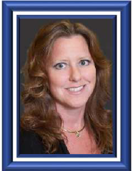
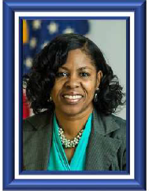
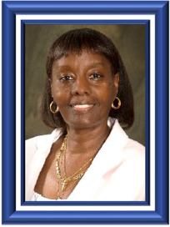
Capital Metro Area
Anita Pursley
Industry Co-Chair
Marketing Mail
Paula Stoskopf
Industry Co-Chair
Periodicals
Tina Dickens
Industry Co-Chair
First-Class Mail
Phone: 704.386.5537
Email: tina.dickens@cms.hhs.gov
Tammy Edwards
Postal Co-Chair
Phone: 301.548.1414
Email: tammy.t.Edwards@usps.gov

